Slide 1
CS222 Algorithms
First Semester 2003/2004
Dr. Sanath Jayasena
Dept. of Computer Science & Eng.
University of Moratuwa
Lecture 12 (02/12/2003)
Dynamic Programming Part 2
0-1 Knapsack Problem

Slide 2
The Knapsack Problem
A thief robbing a store finds n items
The i ^{th} item is worth (or gives a profit of) Rs. p_{i} and weighs w_{i} kilograms
Thief’s knapsack can carry at most c kilograms
p_{i}, w_{i} and c are integers
What items to select to maximize profit?

Slide 3
The Fractional Knapsack Problem
The thief can take fractions of items
Shows optimal substructure property
  After selecting item i with weight w_{i}, fill the remaining capacity c-w_{i} in a similar manner
A greedy strategy works
  Compute the value per kilo p_{i}/w_{i} of each item
  Sort the items by value per kilo
  Take as much as possible from the 1st item
  If can take more, go for 2nd item and so on…
i

Slide 4
The 0-1 Knapsack Problem
Each item must be either taken or left behind (a binary choice of 0 or 1)
Exhibits optimal substructure property
0-1 knapsack problem cannot be solved by a greedy strategy
  Example on the board
Can be solved efficiently by dynamic programming

Slide 5
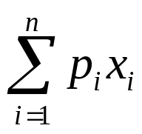
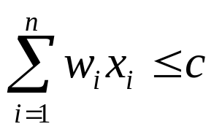
0-1 Knapsack Problem …contd
Let x_{i}=1 denote item i is in the knapsack and x_{i}=0 denote it is not in the knapsack
Problem stated formally as follows
maximize
(total profit)
subject to
(weight constraint)

Slide 6
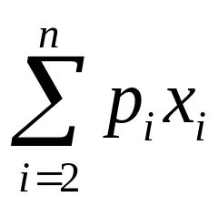
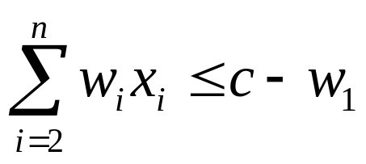
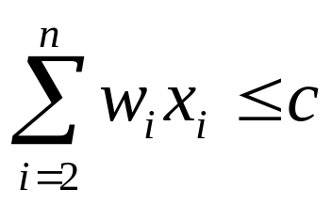
Recursive Solution
Consider the first item i=1
If it is selected to be put in the knapsack
If it is not selected
Compute both cases, select the better one
maximize
subject to
maximize
subject to

Slide 7




Capacity
c
0
Profit
Item 1 not selected
Item 1 selected
1
c
0
c-w₁
p₁
2
2
c
0
c-w₂
p₂
c-w₁
p₁
c-w₁-w₂
p₁+p₂
c
0
c-w₃
p₃
c-w₁
p₁
c-w₁-w₃
p₁+p₃

Slide 8
Recursive Solution …contd
Let us define P(i,k) as the maximum profit possible using items i, i+1,…,n and capacity k
We can write expressions for P(i,k) for i=n and i<n as follows
⎧
0
i
=
n
&
w
>
k
⎪
n
⎪
p
i
=
n
&
w
≤
k
P
(
i
,
k
)
=
⎨
n
n
⎪
P
(
i
+
1
,
k
)
i
<
n
&
w
>
k
i
⎪
Max{P(i+1,k), p_{i}+P (i+1,k-w_{i})}
i
<
n
&
w
≤
k
⎩
i

Slide 9
Recursive Solution …contd
We can write an algorithm for the recursive solution based on the 4 cases
  Left as an exercise (Assignment 8)
  Recursive algorithm will take O(2^{n}) time
Inefficient because P(i,k) for the same i and k will be computed many times
Example:
  n=5, c=10, w=[2, 2, 6, 5, 4], p=[6, 3, 5, 4, 6]

Slide 10




w = [2, 2, 6, 5, 4]
p = [6, 3, 5, 4, 6]
P(1, 10)
P(2, 10)
P(2, 8)
P(3, 10)
P(3, 8)
P(3, 8)
P(3, 6)
Same subproblem

Slide 11
Dynamic Programming Solution
The inefficiency could be overcome by computing each P(i,k) once and storing the result in a table for future use
The table is filled for i=n,n-1, …,2,1 in that order for 1≤ k ≤ c
k | 1 | 2 | … | j-1 | j | j+1 | … | c
P(n,k) | 0 | 0 | … | 0 | p_{n} | p_{n} | … | p_{n}
j is the first k where w_{n} ≤ k

Slide 12
Example
n=5, c=10, w = [2, 2, 6, 5, 4], p = [2, 3, 5, 4, 6]
i\k | 0 | 1 | 2 | 3 | 4 | 5 | 6 | 7 | 8 | 9 | 10
5 | 0 | 0 | 0 | 0 | 6 | 6 | 6 | 6 | 6 | 6 | 6
4
3
2
1

Slide 13
Example …contd
n=5, c=10, w = [2, 2, 6, 5, 4], p = [2, 3, 5, 4, 6]
i\k | 0 | 1 | 2 | 3 | 4 | 5 | 6 | 7 | 8 | 9 | 10
5 | 0 | 0 | 0 | 0 | 6 | 6 | 6 | 6 | 6 | 6 | 6
4 | 0 | 0 | 0 | 0 | 6 | 6 | 6 | 6 | 6 | 10 | 10
3
2
1
+4
+4

Slide 14
Example …contd
n=5, c=10, w = [2, 2, 6, 5, 4], p = [2, 3, 5, 4, 6]
i\k | 0 | 1 | 2 | 3 | 4 | 5 | 6 | 7 | 8 | 9 | 10
5 | 0 | 0 | 0 | 0 | 6 | 6 | 6 | 6 | 6 | 6 | 6
4 | 0 | 0 | 0 | 0 | 6 | 6 | 6 | 6 | 6 | 10 | 10
3 | 0 | 0 | 0 | 0 | 6 | 6 | 6 | 6 | 6 | 10 | 11
2
1
+5

Slide 15
Example …contd
n=5, c=10, w = [2, 2, 6, 5, 4], p = [2, 3, 5, 4, 6]
i\k | 0 | 1 | 2 | 3 | 4 | 5 | 6 | 7 | 8 | 9 | 10
5 | 0 | 0 | 0 | 0 | 6 | 6 | 6 | 6 | 6 | 6 | 6
4 | 0 | 0 | 0 | 0 | 6 | 6 | 6 | 6 | 6 | 10 | 10
3 | 0 | 0 | 0 | 0 | 6 | 6 | 6 | 6 | 6 | 10 | 11
2 | 0 | 0 | 3 | 3 | 6 | 6 | 9 | 9 | 9 | 10 | 11
1
+3

Slide 16
Example …contd
n=5, c=10, w = [2, 2, 6, 5, 4], p = [2, 3, 5, 4, 6]
i\k | 0 | 1 | 2 | 3 | 4 | 5 | 6 | 7 | 8 | 9 | 10
5 | 0 | 0 | 0 | 0 | 6 | 6 | 6 | 6 | 6 | 6 | 6
4 | 0 | 0 | 0 | 0 | 6 | 6 | 6 | 6 | 6 | 10 | 10
3 | 0 | 0 | 0 | 0 | 6 | 6 | 6 | 6 | 6 | 10 | 11
2 | 0 | 0 | 3 | 3 | 6 | 6 | 9 | 9 | 9 | 10 | 11
1 | 0 | 0 | 3 | 3 | 6 | 6 | 9 | 9 | 11 | 11 | 11
+2
+2

Slide 17
Example …contd
n=5, c=10, w = [2, 2, 6, 5, 4], p = [2, 3, 5, 4, 6]
i\k | 0 | 1 | 2 | 3 | 4 | 5 | 6 | 7 | 8 | 9 | 10
5 | 0 | 0 | 0 | 0 | 6 | 6 | 6 | 6 | 6 | 6 | 6
4 | 0 | 0 | 0 | 0 | 6 | 6 | 6 | 6 | 6 | 10 | 10
3 | 0 | 0 | 0 | 0 | 6 | 6 | 6 | 6 | 6 | 10 | 11
2 | 0 | 0 | 3 | 3 | 6 | 6 | 9 | 9 | 9 | 10 | 11
1 | 0 | 0 | 3 | 3 | 6 | 6 | 9 | 9 | 11 | 11 | 11
x = [0,0,1,0,1]
x = [1,1,0,0,1]

Slide 18
Conclusion
Assignment 8
  Assigned today
  Due next week (Dec 9th in class)
Next lecture is the final lecture
  Topic: NP-Completeness

